Slide 1


ABV & IBU: Exploration of Beers
MSDS Consulting Group
Sakava Kiv
Notes:
Slide 1 (intro slide) ( approximately 50 seconds)
Good Evening,
Tonight were going to talk about ABV & IBU Exploration of Beers. I am Sakava Kiv, a Data Scientists who is an expert at helping companies prosper . As you know, the beer industry is a highly competitive and a rapidly evolving market, with a wide range of factors that can impact a company's success. At MSDS Consulting group, we specialize in leveraging data science to help companies make more informed decisions, drive innovation, and stay ahead of their respective industries. Tonight, I'd like to share insights we've gathered from years' worth of data analysis on the breweries and beer industry and what we discovered.

Slide 2

Breweries by State
States with Most Breweries
States with Least Breweries
Colorado – 47
California – 39
Michigan – 32
Oregon – 29
Texas – 28
AL, KS, NH, NJ, TN – 3
AR, DE, MS, NV – 2
DC, ND, SD, WV – 1
11
Mean number of Breweries for US States overall
Notes:
Slide 2 ( approximately 18 seconds)
First, we looked at how many breweries are present in each state. In the past year, we found that the mean number of breweries for US states overall is 11. Here we can see the states with the most breweries and the states with the least breweries and where Budweiser market segments could be focused on.

Slide 3
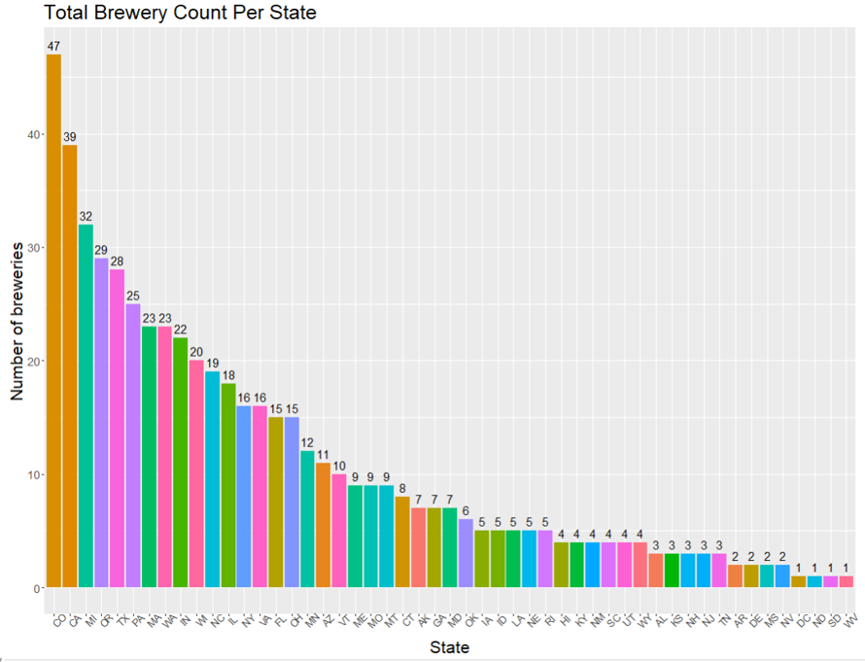
Bar Plot of Breweries by State
Notes:
Slide 3 ( approximately 50 seconds)
We can see that Colorado has the highest number of breweries, with 47 breweries in total, followed by California with 39 breweries. On the other hand, the states with the lowest number of breweries are DC, North Dakota, South Dakota, and West Virginia, each with only one brewery. It's interesting to note that many of these states have smaller populations and may not have as much demand for beer as other states, which could explain the lower number of breweries. Overall, this plot can provide valuable insights into the competitive landscape of the beer industry and can be used to inform decision-making around market expansion, distribution, and branding strategies.

Slide 4
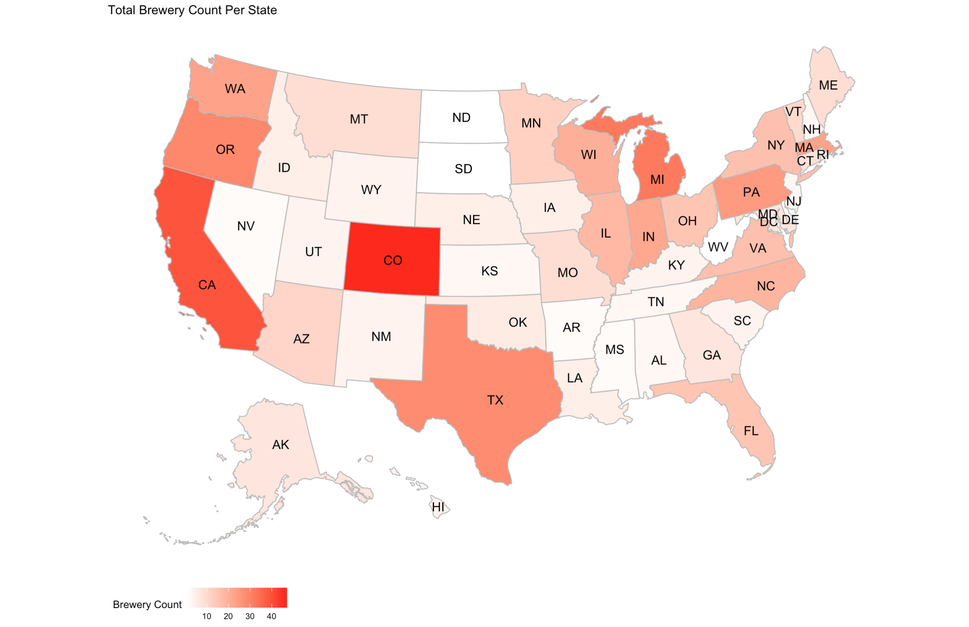

Colorado has the Most Breweries!
Notes:
Slide 4 ( approximately 50 seconds)
Clearly, Colorado has the highest number of breweries being the darkest shade of red. Overall, this map provides a great overview of the distribution of breweries across the US. It allows us to see patterns and trends in the data, which may not be immediately apparent from looking at raw data alone. This information can be useful identifying potential opportunities for growth by geographic location.

Slide 5
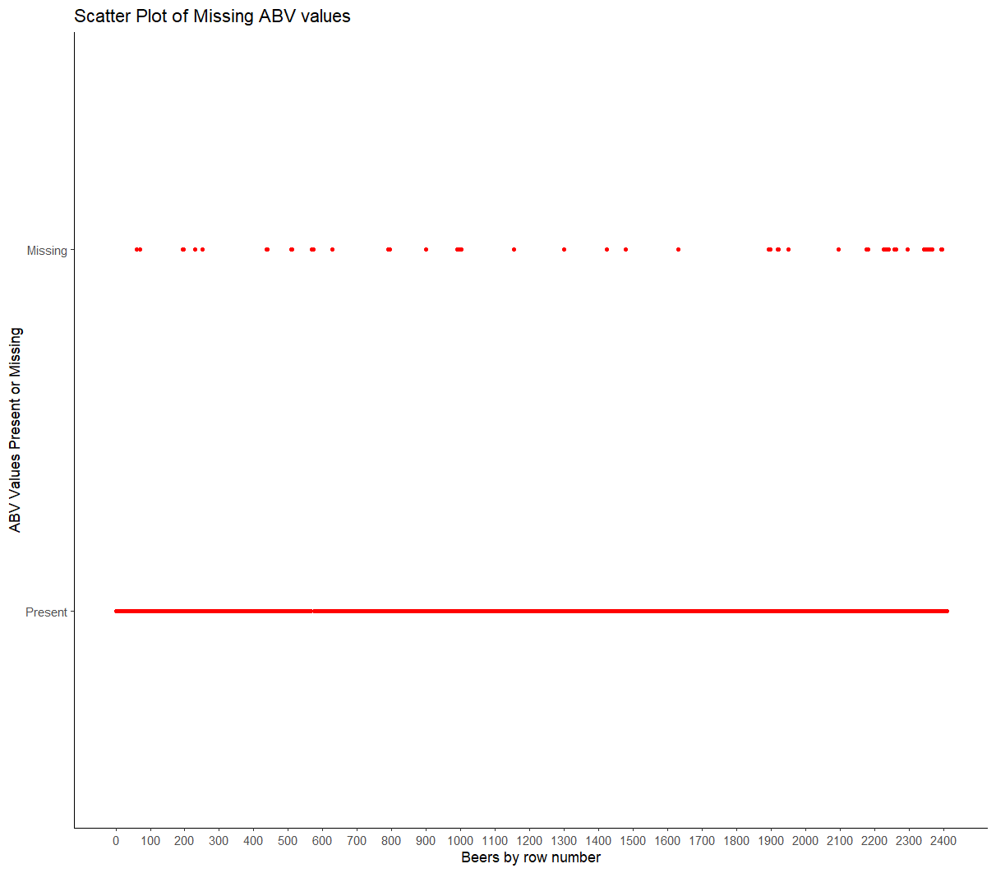
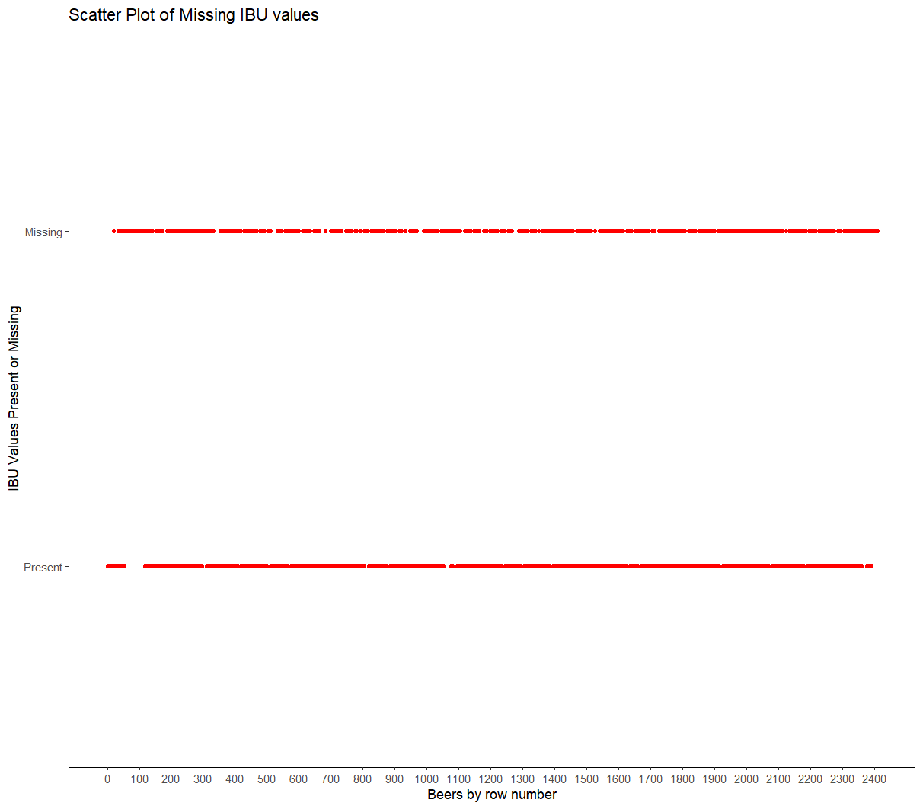
Is the Data MCAR?
ABV Missing Data
IBU Missing Data
Notes:
Slide 5 ( approximately 45 seconds)
Is the Data Missing Completely at Random?
We addressed the missing values in each column found in our data. Specifically, we found that there were some missing values in the ABV and IBU columns for quite a few beers across different breweries. So, we wanted to see the missing ABV and IBU values to get an idea as to how those data points are spread across the beers overall.

Slide 6

Notes:
Slide 6 ( approximately 20 seconds)
We can see the missing ABV values spread out over the many present ones in this dataset. This gives us confidence that suggests that the data is missing completely at random, so we do not need to include those beers with missing values in our analysis.

Slide 7
Notes:
Slide 7 ( approximately 67 seconds)
We plotted the missing IBU values alongside the present IBU values and the scatter plot presents the missing values that are spread out randomly across the dataset. This is good news, because if the missing values were systematic, it could indicate errors in the data collection process. This random distribution suggests that the missing values is due to chance and not related to any specific characteristics of the different beers in style, state location, or the dataset. Overall, this insight provides us with confidence that the records aren't missing due to any specific bias or systematic errors.

Slide 8
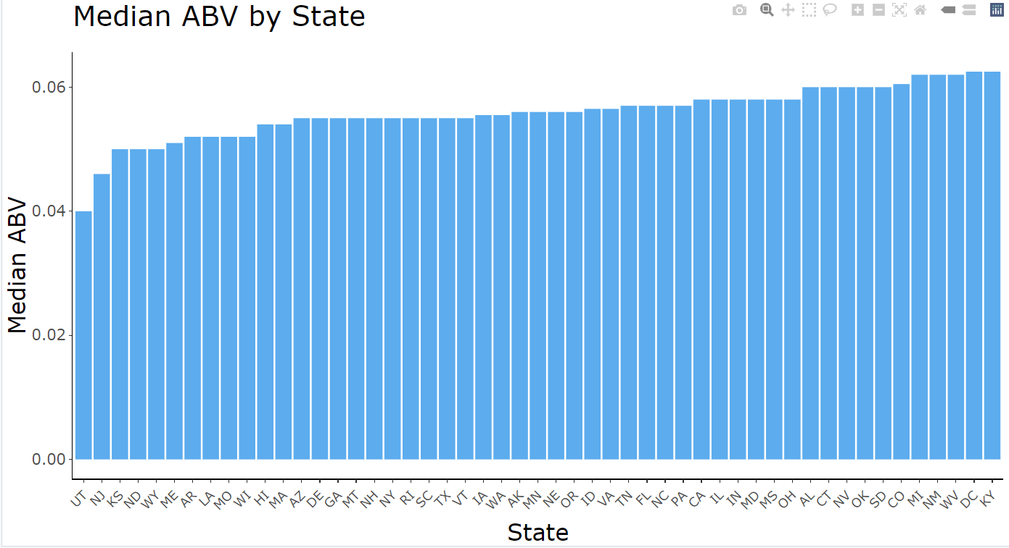
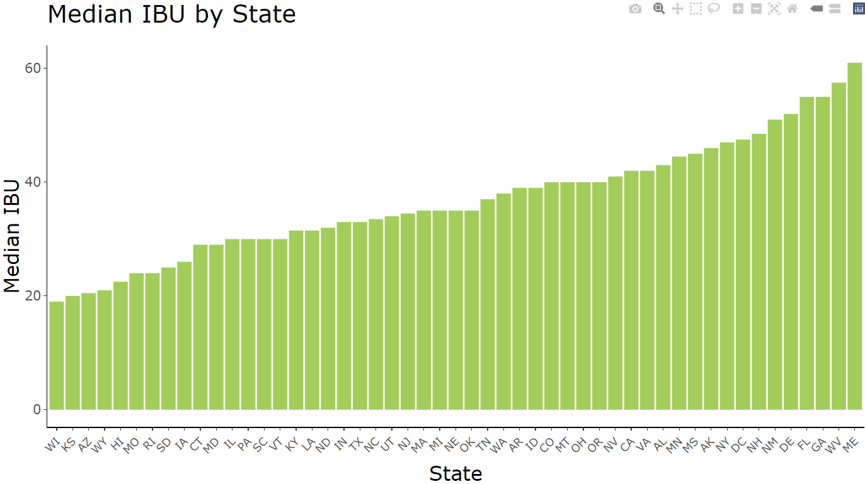
ABV & IBU by State
Median ABV by State
Median IBU by State
Notes:
Slide 8 ( approximately 50 seconds)
Moving on, we computed the median Alcohol By Volume or ABV. It is a standard measure used to indicate the alcoholic percentage in beverages. And the International Bitterness Units (IBU) measures the bitterness of the beer, which is primarily determined by the number of hops used during the brewing process. The IBU's are used to provide a standardized scale for measuring bitterness from 0 (no bitterness) to over a 100 (extremely bitter).

Slide 9

Median ABV by State
Median ABV
Notes:
Slide 9 ( approximately 16 seconds)
We can observe that DC and Kentucky have the highest median ABV of 6.25%, while Utah has the lowest median ABV of 4%.

Slide 10
Median IBU by State
Notes:
Slide 10 ( approximately 15 seconds)
In terms of IBU, Maine has the highest median IBU of 61, while Wisconsin has the lowest median IBU of 19.

Slide 11
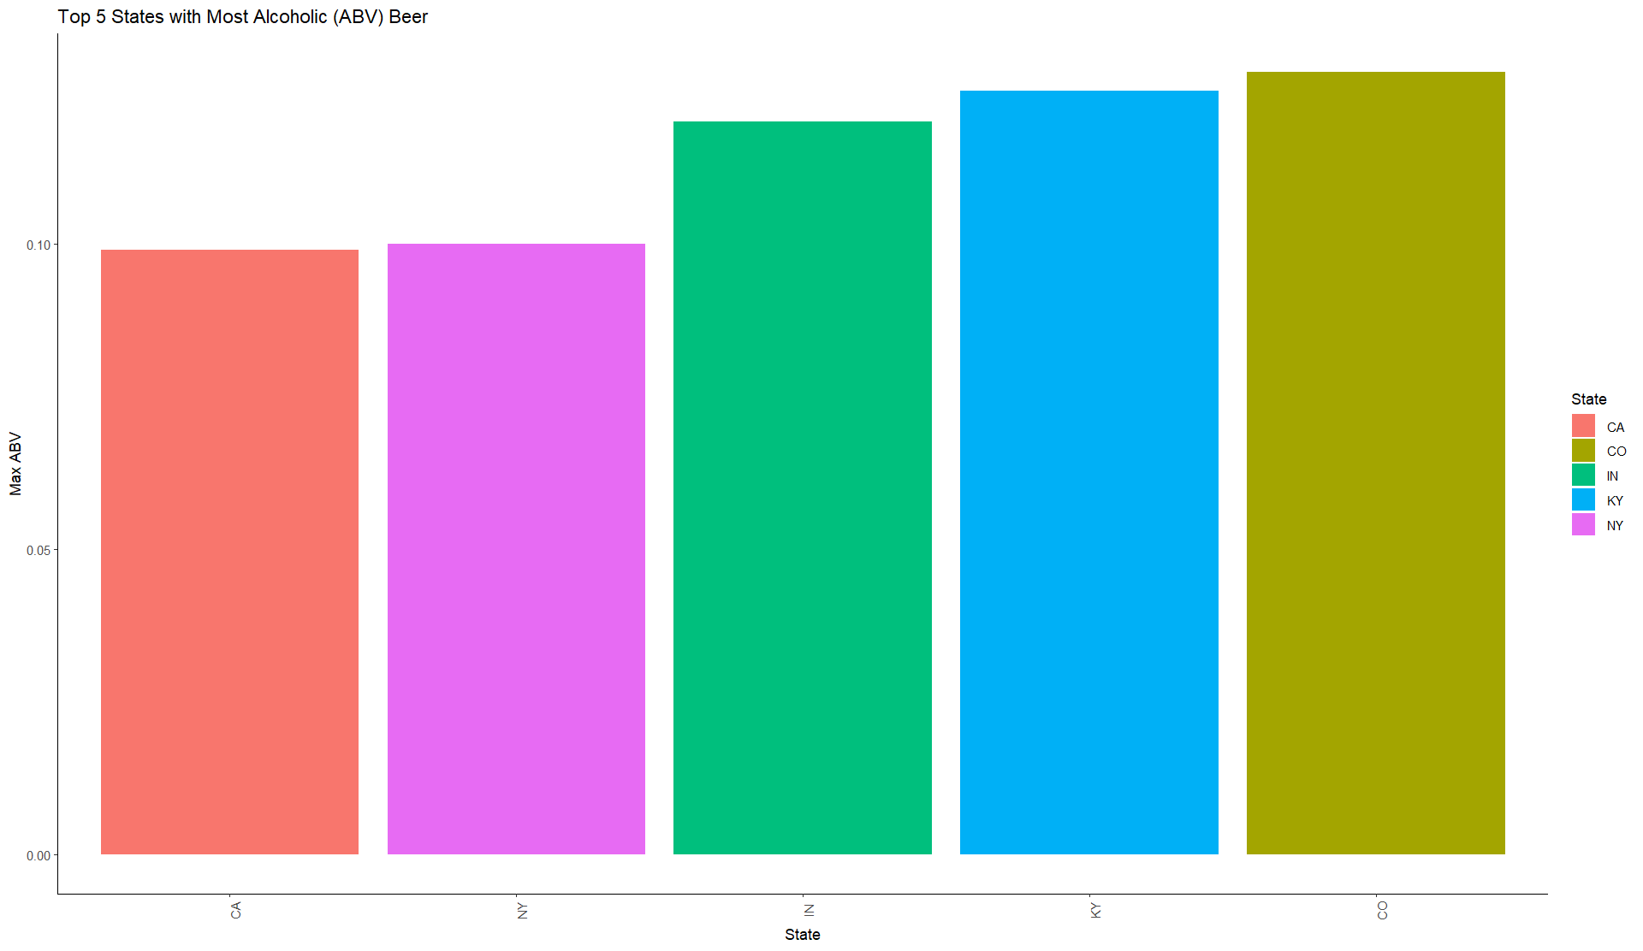
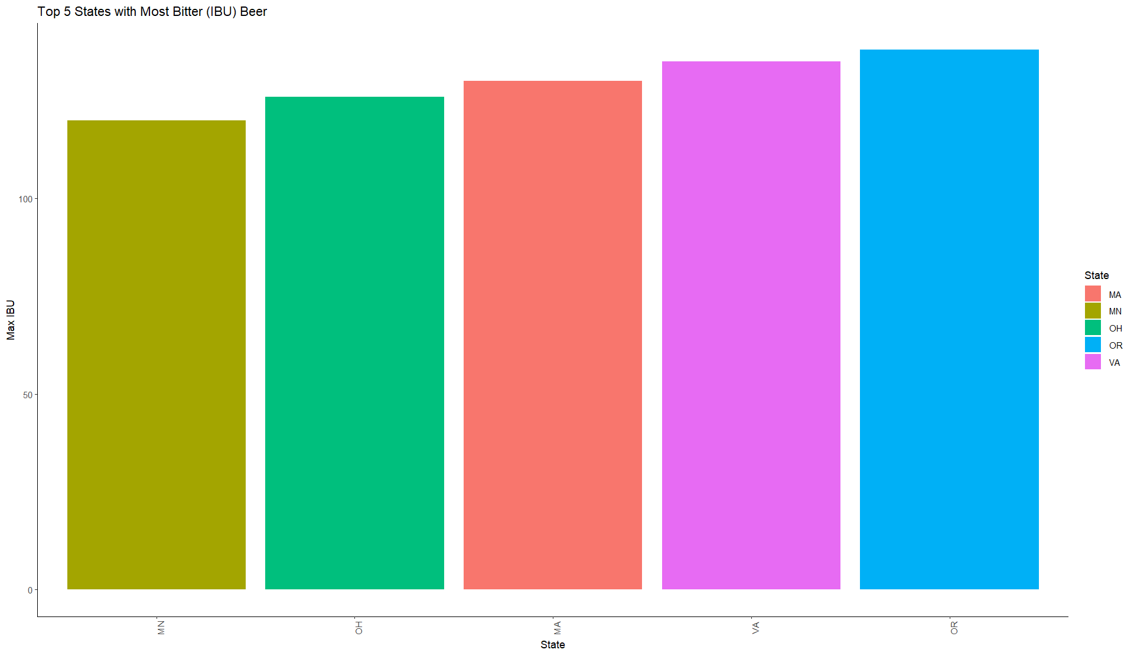
Maximum ABV & IBU by State
Top 5 Maximum ABV by State
Top 5 Maximum IBU by State
Notes:
Slide 11 ( approximately 18 seconds)
Moreover, we found which state had the beers with the highest (ABV) and IBU values. So, for the ABV & IBU we can observe the top 5 states respectively.

Slide 12
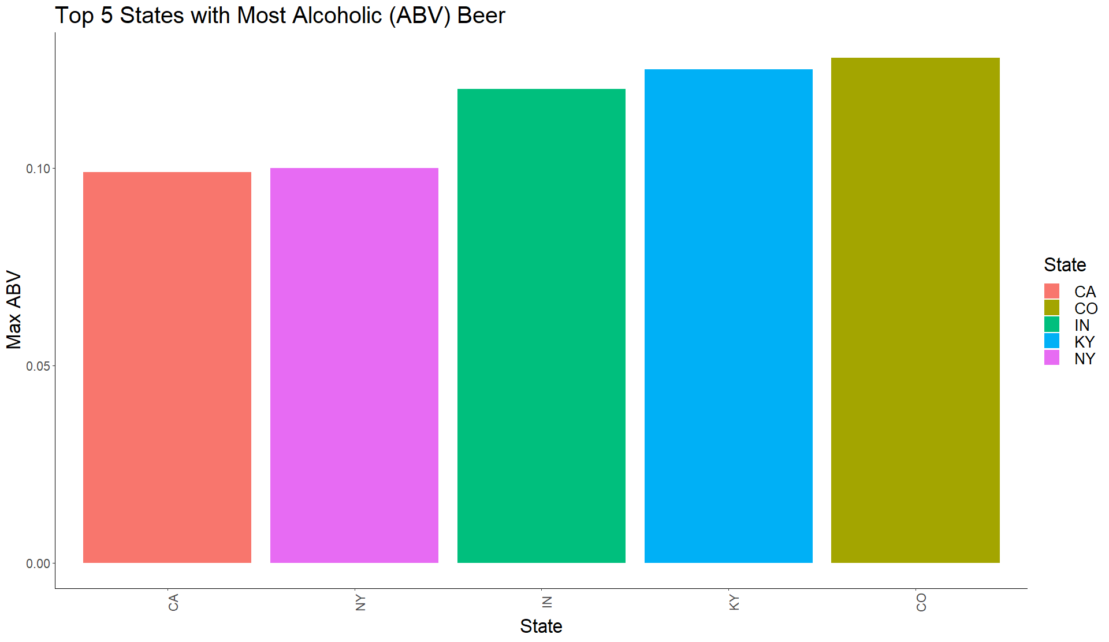
Top 5 Maximum ABV by State
KY
12.5%
CO
12.8%
IN
12%
CA
9.9%
NY
10%
Notes:
Slide 12 ( approximately 11 seconds)
We can see the state of Colorado takes the number one spot, with an ABV of 12.8%.

Slide 13
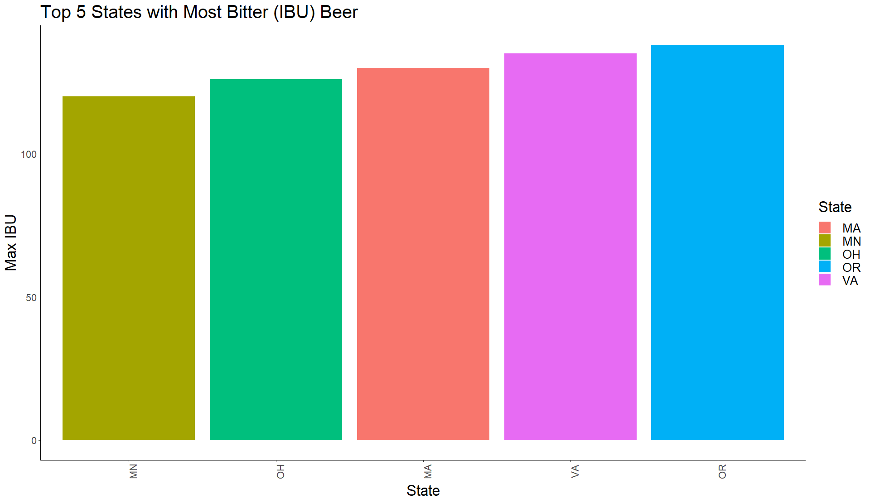
Top 5 Maximum IBU by State
VA 135
OR
138
OH
126
MA
130
MN
120
Notes:
On the other hand, for the top 5 most bitter (IBU) beers we can see Oregon to be the winner this time, with a whopping IBU score of 138.

Slide 14
Summary Statistics of ABV Data
Minimum | 0%
1st Quarter | 5%
Median | 5.6%
Mean | 5.97%
3rd Quarter | 6.7%
Maximum | 12.8%
Minimum ABV level is 0% for non-alcoholic beer
Maximum ABV level is 12.8%
Median ABV level is 5.6%
Average ABV level is 5.97%
Notes:
Here we can see a table of the summary statistics.
Observe that we have the minimum ABV level of 0% for non-alcoholic beers, a maximum ABV level of 12.8%, a Median ABV level of 5.6% and a Mean ABV level of 5.97%.

Slide 15
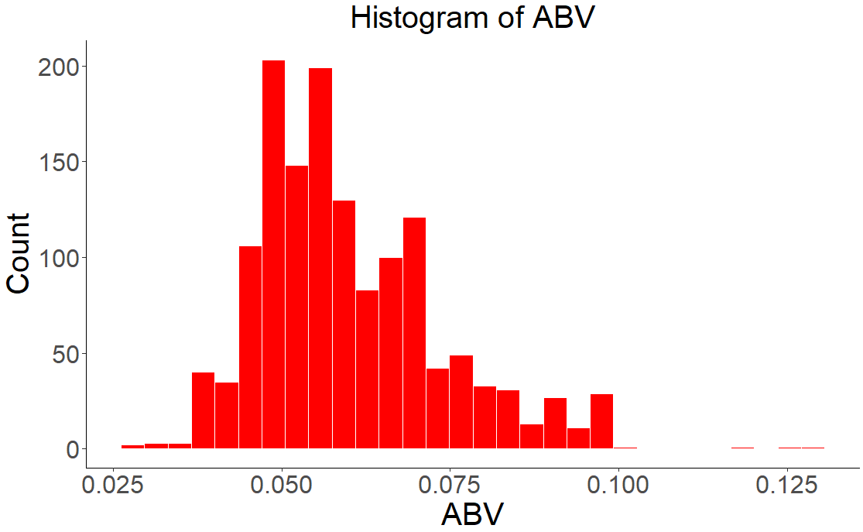
ABV Distribution
Notes:
Slide 15 ( approximately 55 seconds)
Here we see a histogram of ABV values. Observe that there is a wide range of values for the ABV variable, with many of the value in the range of 4-7%. The distribution appears to be unimodal. Also notice the histogram is roughly symmetric except for the long right tail, which indicates that there are some beers with high ABV values that are considered outliers in this case a Colorado beer.
In general, the ABV variable shows a reasonable range and distribution of values for beer, with most of the beers having a relatively moderate alcohol content.

Slide 16
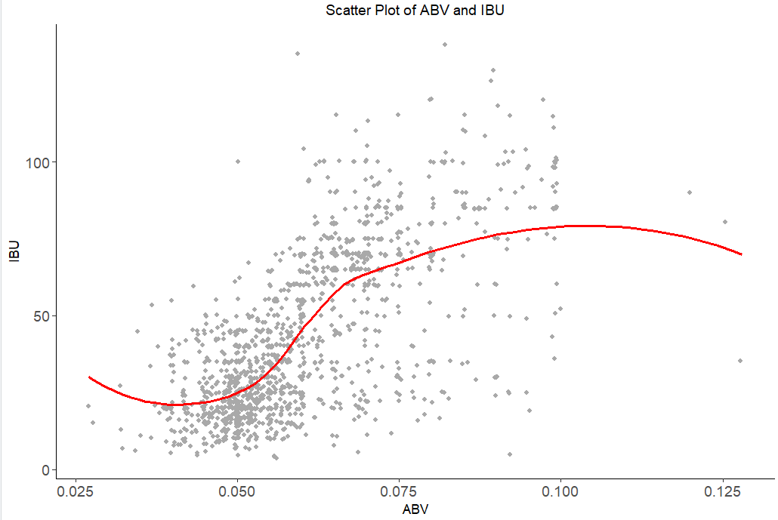
Relationship of ABV vs. IBU
Notes:
Slide 16 ( approximately 69 seconds)
Now we explored if there exist an apparent relationship between the bitterness of the beer and its alcoholic content. We can observe this relationship between the alcoholic content (ABV) and bitterness (IBU) of the beers.
The gray dots represent individual beers, and the red line represents a smoothed curve fit of the data.
Overall, there appears to be a slight positive relationship associated between ABV and IBU, but we can see a downward trend later since we account for an outlier that has a high ABV but lower IBU. As the alcoholic content of beer increases, so does its bitterness, as indicated by the general upward trend of the red curve. However, the relationship is not very strong, as there is quite a bit of variability in IBU values for any given ABV value. This suggests that while there is some relationship associated between ABV and IBU, other factors such as the type of beer, brewing methods, and ingredient choices are also important in determining the bitterness of a beer.

Slide 17
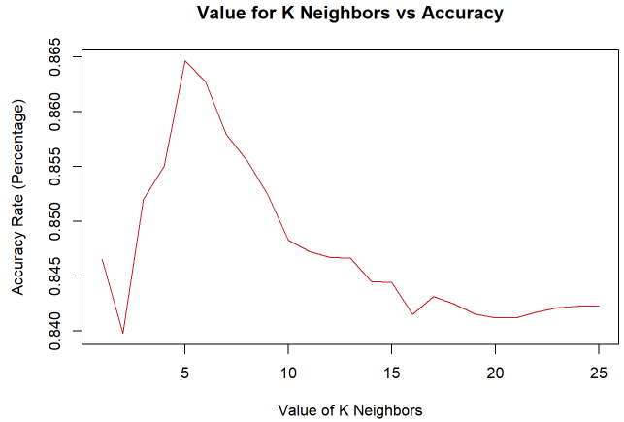
Finding the best K value
Notes:
Slide 17 ( approximately ? seconds)
Furthermore, we wanted to identify whether there is a relationship between a beer's ABV and IBU values and its classification as an IPA or Ale. To answer this question, we used a machine learning technique called K-Nearest Neighbors to classify beers as either an IPA or Ale based on their ABV and IBU values. To do this, we first ran this analysis multiple times with different training and testing data sets and different values of k, which is the number of nearest neighbors used in the classification. Here we happened to see our best k value is 5 with an accuracy rate around 86%.

Slide 18
Confusion Matrix and Statistics
 | Predicted Class
Actual Class | Classifications | Ale | IPA
 | Ale | 133 | 13
 | IPA | 31 | 108
Accuracy = 0.8456
Notes:
Slide 18 ( approximately ? seconds)
The confusion matrix here is a two by two table that summarizes the performance of a classification model by comparing its predictions to the actual labels in a test dataset. Here the rows correspond to the actual classifications and the columns correspond to the predicted classifications. Here we treat Ale as being the positive classification and IPA being the negative classification. The four possible outcomes are:
True positive (TP): The model correctly predicts Ale in this case when the actual is Ale. So, we have 133 beers correctly classified as Ale
False positive (FP): The model predicts Ale when the actual is IPA. So, we have 31 beers incorrectly classified as Ale’s when they were really IPA’s (type 1 error)
False negative (FN): The model predicts IPA when the actual is ALE. So, we have 13 beers that are actually ALE’S but were predicted to be IPAs. (type 2 error)
And
True negative (TN): The model correctly predicts IPA in this case when the actual is IPA. So, we have 108 beers that are correctly classified as not being ALE’s.
We can observe that the statistic performance results of this KNN model accurately classifies a beer as an ALE or IPA with an 84 percent accuracy rate, which is pretty good. So, we are confident that this Machine learning KNN model is correctly classifying the beers based of the associated relationship of ABV and IBU.

Slide 19
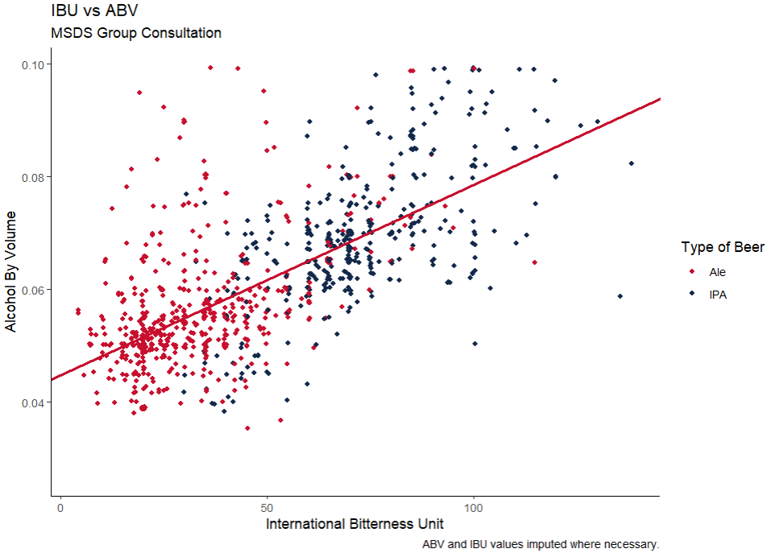
Linear Correlation Model
Notes:
Slide 19 ( approximately ? seconds)
We can visualize the decision boundary for the KNN model, which is a straight line that separates the different types of beers based on their ABV and IBU values. The KNN model uses this boundary to classify new beers as either Ales or IPAs. In general, we can see that IPAs tend to have higher IBU and ABV ranges, but there seems to be also some overlap between the two groups. The decision boundary is set in such a way as to maximize the accuracy of the KNN model in classifying the beers

Slide 20
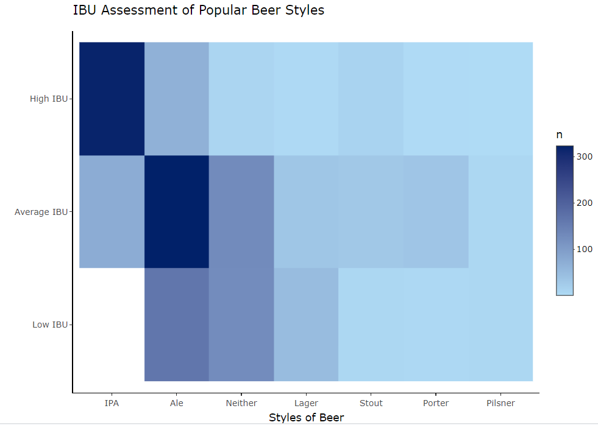
IBU Assessment of Popular Beer Styles
Notes:
Slide 21
We can infer from this heat map that Budweiser could adjust their beer offerings to include more IPAs and ALEs, particularly those with high IBU values and average IBU respectively, to meet customer demand and capitalize on this popular beer style.

Slide 21
Conclusion
In general IPAs are more bitter than ALEs
In general IPAs have higher ABVs than ALEs
but there still seems to be overlap of these characteristics between these two types of beers.
Notes:
Slide 22 ( approximately ? seconds)
In general IPAs have Higher ABVs and IBUs than ALEs, but sometimes there is also overlap of these characteristics. Budweiser could design new beers based on these characteristics and classify their beers as IPAs or ALEs and market these in states or regions where the demand is high for these styles. I hope this information is useful in your decision-making processes.

Slide 22
Thank you
MSDS Consulting Group
Sakava Kiv
Email: sak2000.kiv@gmail.com
Notes:
Ending Slide
Now, Thank you for joining me today for this presentation. Again, my name is Sakava Kiv representing the MSDS Consulting Group and I hope you found it informative and engaging.
If you have any further questions or would like to discuss the topics covered in more detail, please don't hesitate to reach out to me.
You can contact me via email at sak2000.kiv@gmail.com.
Thank you again for your time and attention. Have a great evening!

